Slide 1


Slide 8
Here Goes Your
Your Presentation Title
And here you can write a subtitle.

Slide 9
We will talk about this first.
01
Add a brief introduction of your section here.
Let’s dive in and get to know some interesting facts about animals!

Slide 10
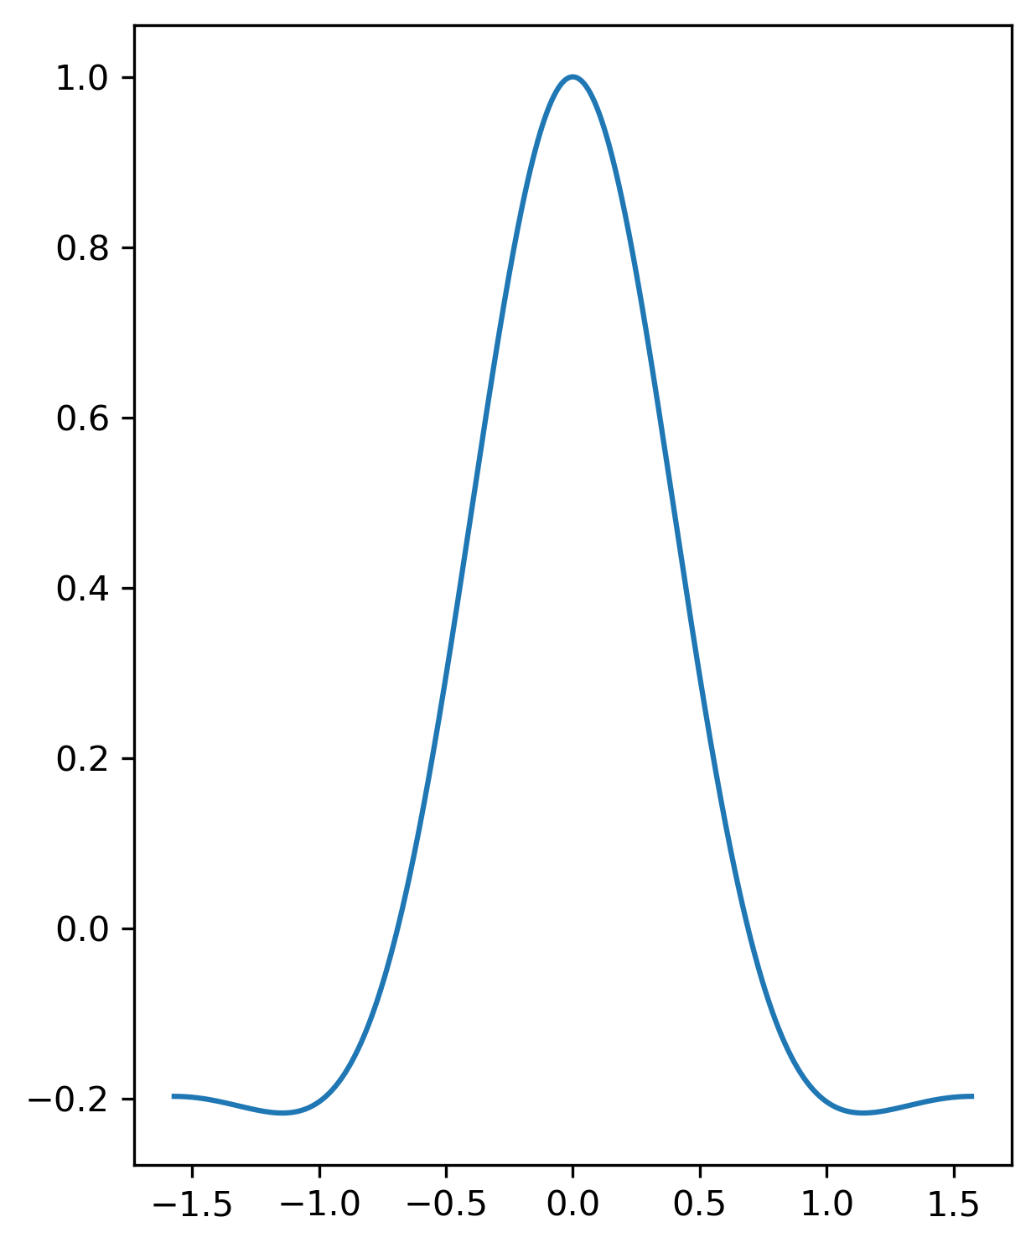

Ultraschall Lautsprecher a = λ/2

